Slide 1

Day-1 of PowerShell
Fundamentals of PowerShell

Slide 2
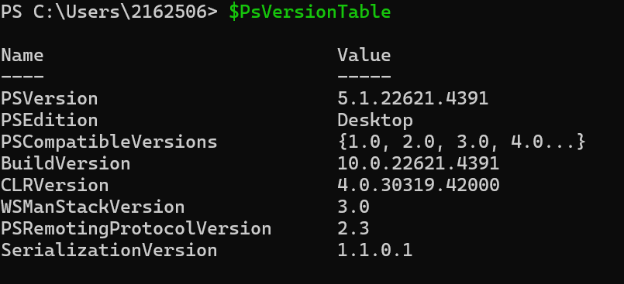
Intro
PowerShell is a cross-platform and Object-oriented automation engine.
It runs on Windows , Linux and MacOS.
It Is mainly used for IT Professionals and system admins to control and automate the management of the systems and other apps.

Slide 3
What is configuration Management?
DSC(Desired State Configuration) – PowerShell framework to manage your Infra with Configuration as a code.
File extension PowerShell Script/file
text.ps1
PowerShell Supports
Variables
Functions
Conditions (if-else)
Loops (while, do, for, and foreach)
Error Handling (error/exceptions)
In Ps we call each unique function as cmdlets

Slide 4
PowerShell cmdlets format
In Ps we use a verb-noun format
Get - to get something
New – to create something
Set – to define something
Remove – to remove something
Start- to run something
Stop – to stop something that is running
Out – to output something

Slide 5
What is a PowerShell Module?
A module is a package that contains Ps members, such as cmdlets, providers, functions, workflows, variables, and aliases.
PowerShell gallery is the central repository for PowerShell content.
Pipeline | - what is a pipeline? - A pipeline is an operator that would help user to pipe/pass the output of the first cmdlet as an input to the first cmdlet.

Slide 6
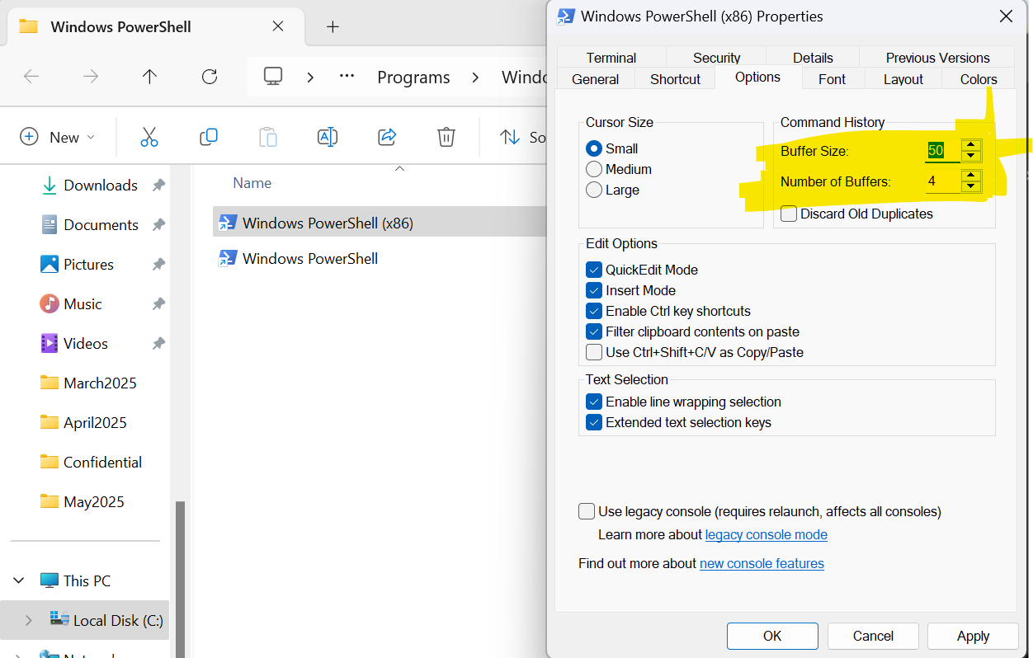
Command History
- Get-History(fetches the history of cmdlets based on the buffer you setup)
Invoke-History (This will help you execute a specific cmdlet from the history of cmds executed)
Clear-History (Clear complete history or clear a specific cmdlet using history Id)
Ps history is inbuilt

Slide 7
Help Utility
Get-Help – Syntax/Context help utility
Get-Command – List out all the types of cmdlets available within Ps installed.
E.g. Get-Help Set/Get-Command cp

Slide 8
Day-2 of PowerShell
Fundamentals of PowerShell

Slide 9
Installation of PowerShell in Linux
sudo apt-get update > sudo apt-get install –y wget apt-transport-https software-properties-common > wget –q https://packages.microsoft.com/config/ubuntu/20.04/packages-microsoft-prod.deb > sudo dpkg -i packages-microsoft-prod.deb > sudo apt-get update > sudo apt-get install –y powershell [for centOS- use curl & yum)
- To remove Ps: sudo apt-get remove powershell
$ pwsh
Note: Enable the universe repository in ubuntu 18/20 before installing PowerShell. (sudo add-apt-repository universe)

Slide 10
ISE (Integrated Scripting Env)
Use backtick to execute cmds in multiple lines
Get-Process | Where-Object {$_.mainWindowTitle} `
| Where-Object {$_.mainWindowTitle} `
|Format-Table Id, Name, mainWindowTitle `
-AutoSize

Slide 11
PowerShell Profile
PS C:\Users\2162506> Test-Path $Profile
PS C:\Users\2162506> $PROFILE | Get-Member -Type NoteProperty
PS C:\Users\2162506> notepad $PROFILE
PS C:\Users\2162506> notepad $PROFILE.AllUsersAllHosts
PS C:\Users\2162506> New-Item -Path $Profile -Type File –Force PS C:\Users\2162506> Test-Path $Profile
PS C:\Users\2162506> Test-Path $Profile -Type File -Force C:\Program Files\WindowsPowerShell

Slide 12
PowerShell Customization
PS C:\Users\2162506> $host.UI.RawUI.WindowTitle = “yourname"
To customize your PowerShell window name use the above cmd.

Slide 13
Execution Policy
PS C:\Users\2162506> Get-ExecutionPolicy
Bypass/RemoteSignd/AllSigned
PS C:\Users\2162506> Set-ExecutionPolicy -ExecutionPolicy AllSigned
PS C:\Users\2162506> Set-ExecutionPolicy -ExecutionPolicy AllSigned –Scope CurrentUser
PS C:\Users\2162506> Set-ExecutionPolicy -ExecutionPolicy Undefined
PS C:\Users\2162506> Set-ExecutionPolicy -ExecutionPolicy Undefined –Scope CurrentUser

Slide 14
Shortcut Keys
Alt+F4 = CLOSE WINDOW
Tab = Auto Completion
Ctrl+Home= Deletes all the chars from current position to the beginning of the cmd line
Ctrl+End= Deletes all the chars from current position to the end of the cmd line
Alt+F7 = Deletes the current cmd history

